Slide 1
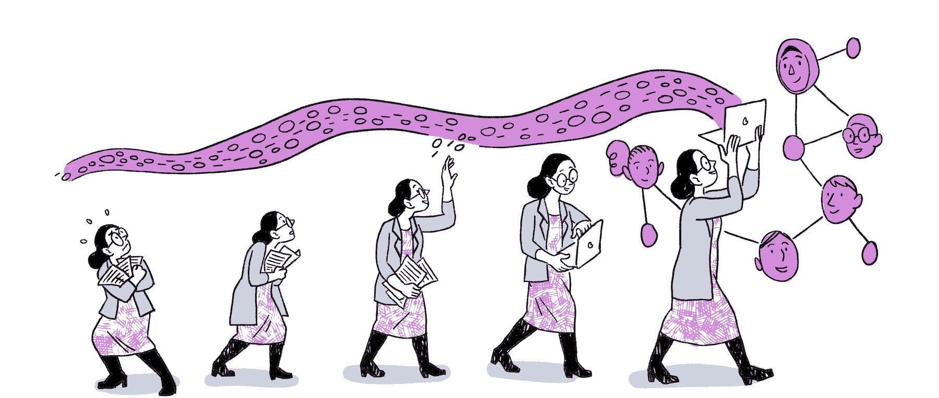
Open Scholarship in Research:
why is it important, and small steps to get you started
Aaron Johnson, Concordia University

Slide 2
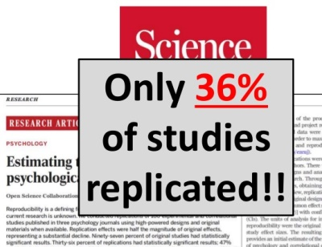
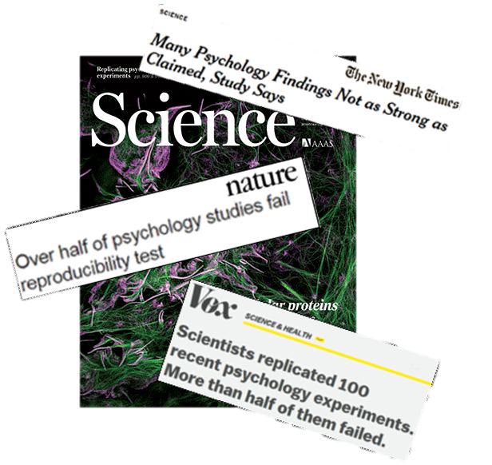
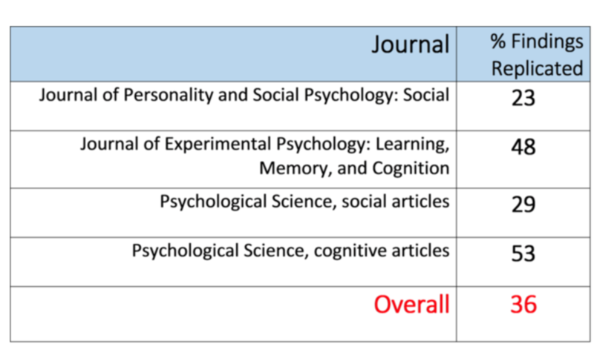
Is Academia in Crisis?
Notes:
2015 Article in Science – estimating reproducibility of psychological studies. Ran 100 experiments, only replicated ~36% of results.

Slide 3
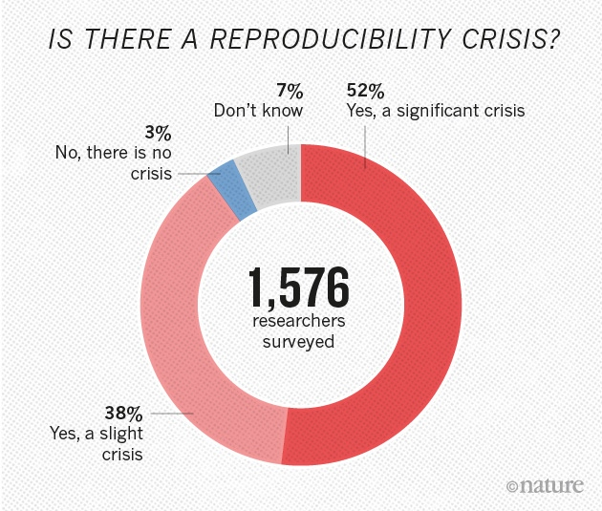
https://www.nature.com/articles/533452a

Slide 4
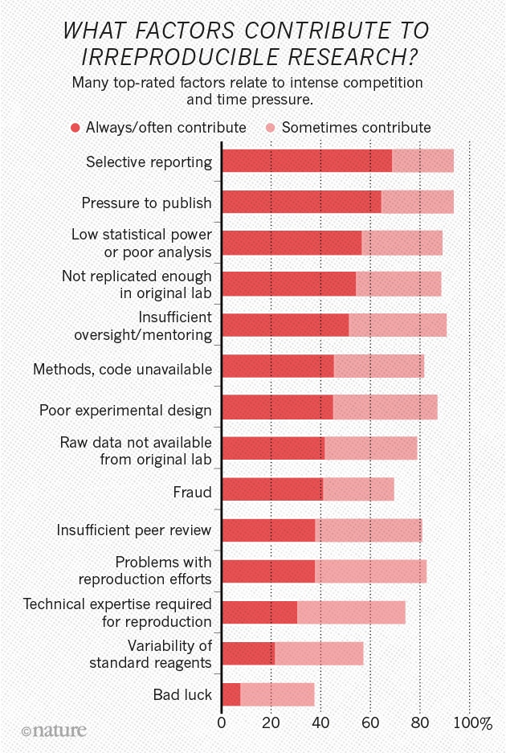
https://www.nature.com/articles/533452a

Slide 5
Currently identified issues
Publication bias
P-hacking
  Inappropriate manipulation of data to enable a favoured result.
  58% of researchers admit to peeking at the results and then decided whether to collect more data, 43% had decided to throw out data only after checking its impact on the p-value (Loewenstein et al., 2012)
Omission of crucial details for proper replication of full study
Inappropriate methods e.g., multiple comparison problem.
Notes:
Pressure to publish already finished ”set in stone” experiments
Psychologist Uri Simonsohn at the University of Pennsylvania, gives an explicit nod to this naivety in his definition of 'p-hacking': “Exploiting — perhaps unconsciously — researcher degrees of freedom until p < 0.05.”

Slide 6
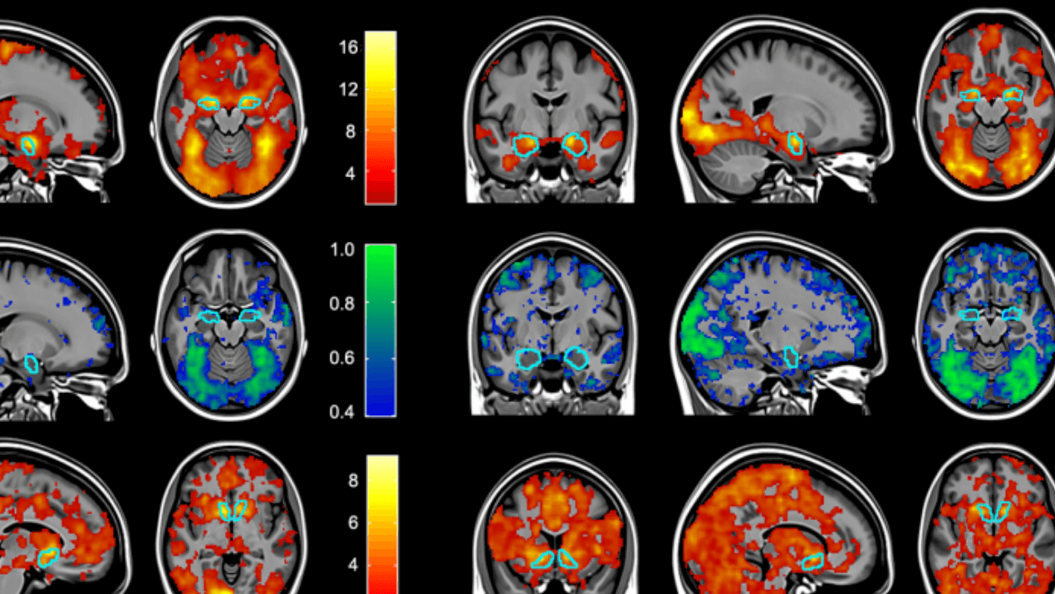

Slide 7
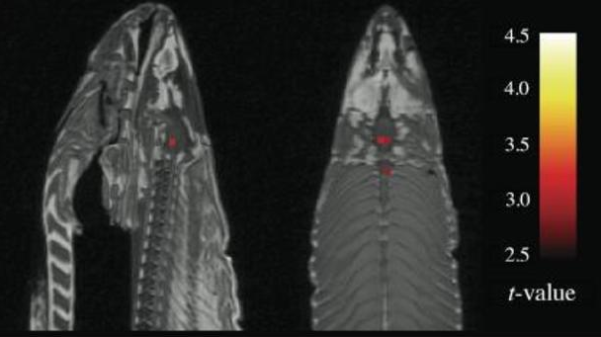
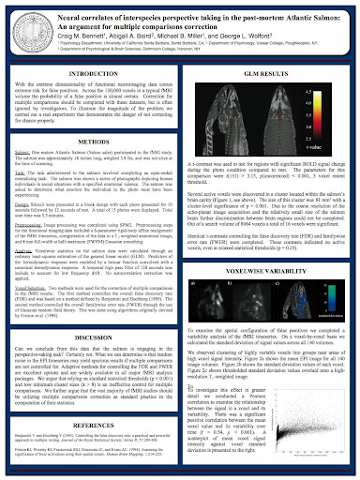
http://prefrontal.org/files/posters/Bennett-Salmon-2009.pdf
Notes:
So, as the fish sat in the scanner, they showed it "a series of photographs depicting human individuals in social situations." To maintain the rigor of the protocol (and perhaps because it was hilarious), the salmon, just like a human test subject, "was asked to determine what emotion the individual in the photo must have been experiencing.”
If that were all that had occurred, the salmon scanning would simply live on in Dartmouth lore as a "crowning achievement in terms of ridiculous objects to scan." But the fish had a surprise in store. When they got around to analyzing the voxel (think: 3-D or "volumetric" pixel) data, the voxels representing the area where the salmon's tiny brain sat showed evidence of activity. In the fMRI scan, it looked like the dead salmon was actually thinking about the pictures it had been shown.

Slide 8
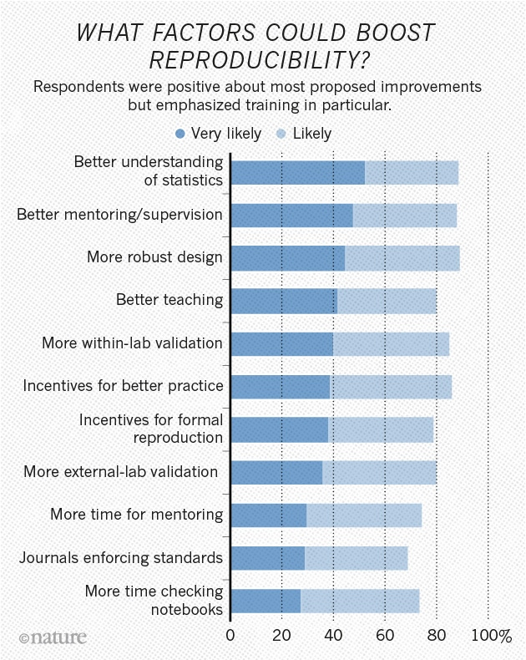
https://www.nature.com/articles/533452a

Slide 9
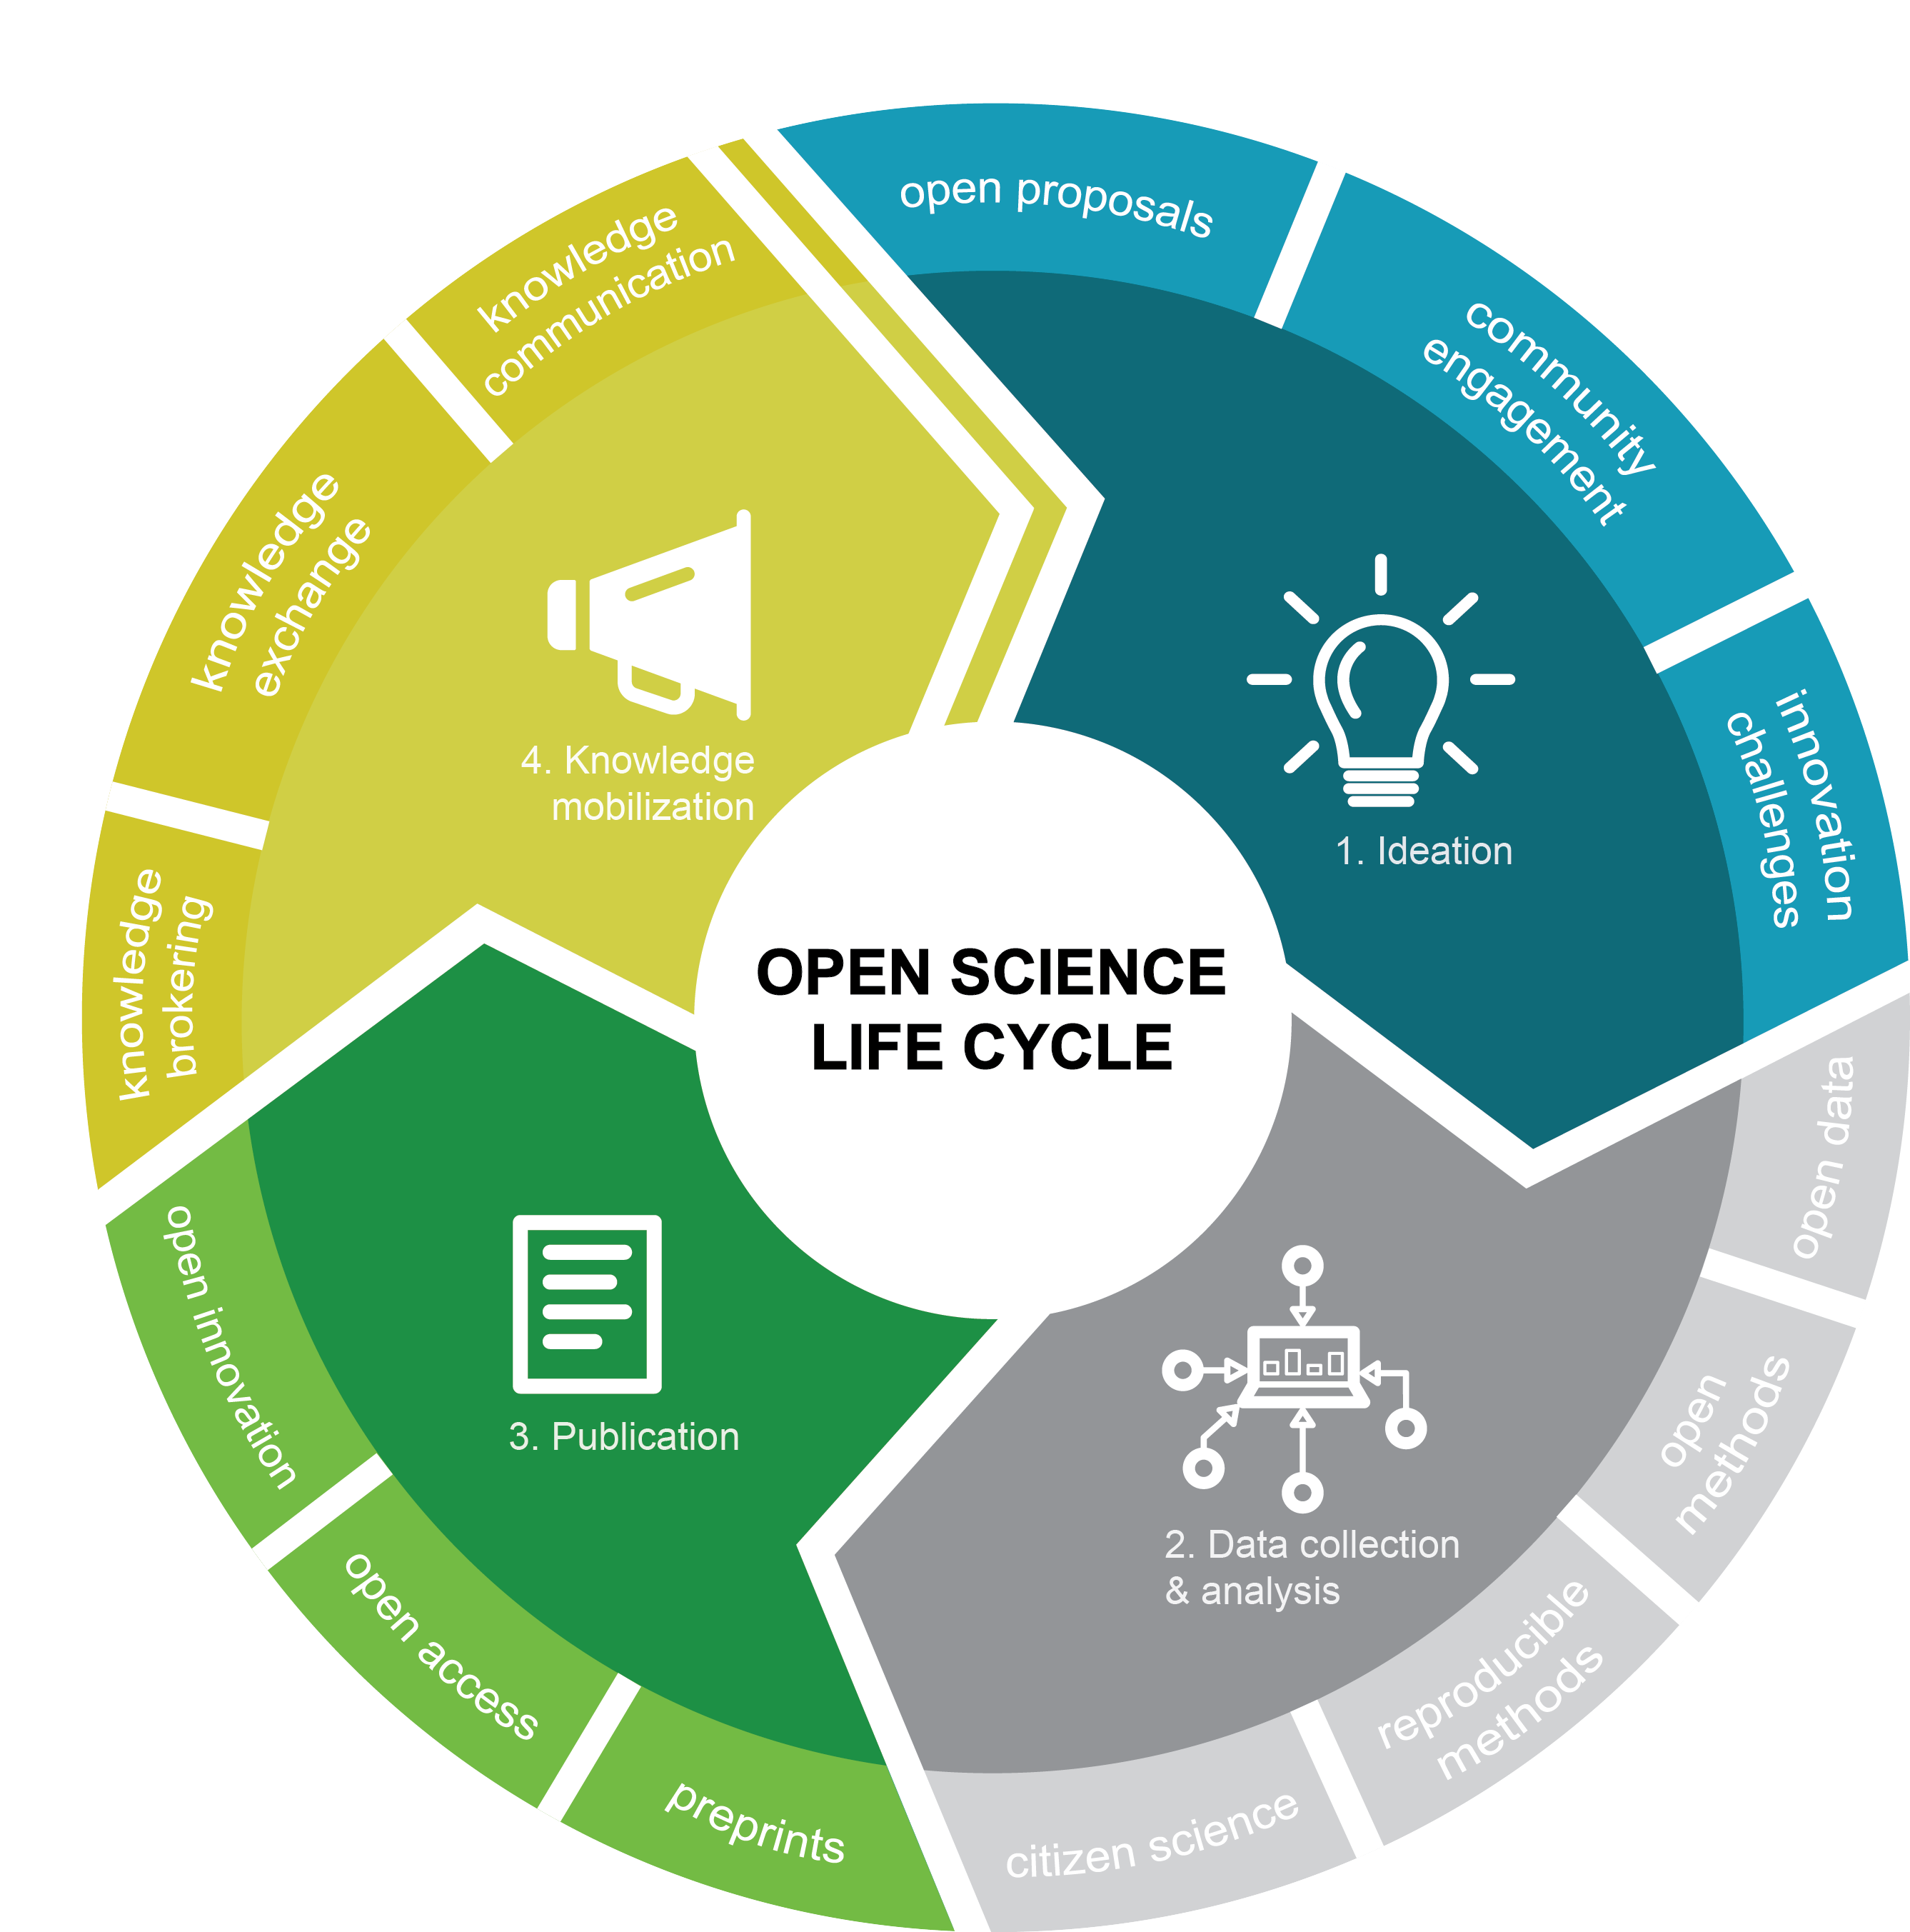
https://science.gc.ca/eic/site/063.nsf/eng/h_98054.html
Notes:
Roadmap for Open Science (the Roadmap), to provide a plan for greater openness in federal science and research activities. The Roadmap was published by the Chief Science Advisor of Canada on February 26th, 2020.
Open science aims to make each of these stages more inclusive and accessible to other scientists and Canadians. The open science life cycle includes:
Tackling innovation challenges and engaging the community during ideation
Encouraging citizen science and integrating open methods and open data during data collection and analysis
Encouraging access to publications prior to peer review (preprints) as part of the publication process
Using open access publications to exchange and communicate data and information during the final stage of knowledge mobilization
Open Access by Jan 2022
FAIR by Jan 2025

Slide 10
More than open access publishing
“Open Science, the movement to make scientific products and processes accessible to and reusable by all, is about culture and knowledge as much as it is about technologies and services.”
(https://open-science-training- handbook.gitbook.io/book/introduction)

Slide 11
What is Open Science / Scholarship?
“Open Science is the practice of science in such a way that others can collaborate and contribute, where research data, lab notes and other research processes are freely available, under terms that enable reuse, redistribution and reproduction of the research and its underlying data and methods. In a nutshell, Open Science is transparent and accessible knowledge that is shared and developed through collaborative networks.”
(Vicente-Sáez & Martínez-Fuentes 2018)

Slide 12
Think about it…
What could you do with open scholarship? What could you study? What could you learn?
What opportunities would present themselves, if...
  All data (in your field) were available online
  All algorithms (in your field) were available online
  All publications (in your field) were open access
Most of these opportunities are not little steps forward; instead, they promise to be revolutionary!

Slide 13
Benefits of Open Scholarship
Open scholarship makes the work accessible to anyone.
Open scholarship allows people to build much more efficiently on previous work.
Open scholarship helps maximize the usefulness of each individual research effort (e.g., mine old data, and lots of it!).
Data tend to have a (much!) longer shelf life than our (limited) interpretations.
Open scholarship fosters creativity, and stimulates revolutionary research
Importance of networking.

Slide 14
Why should research be open?
Evaluation requires full understanding of Methods
Reproducibility
Replicability
Impact
Accelerate discovery
  Share data
  Share code
  Share everything!

Slide 15
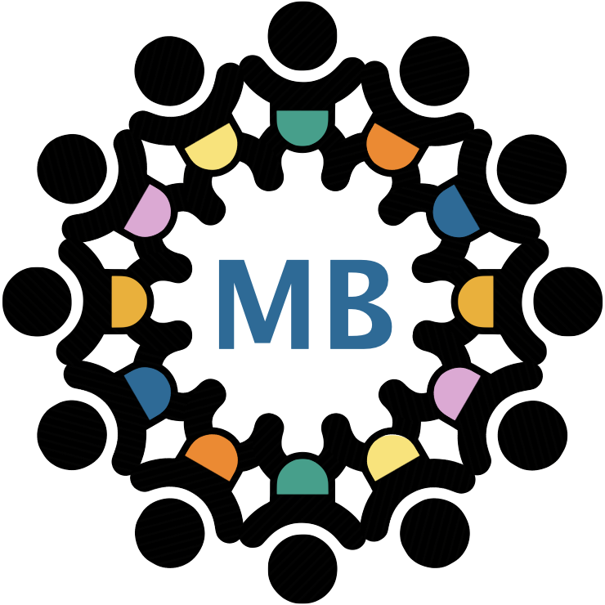
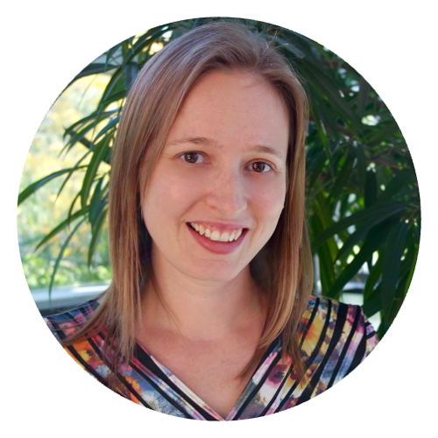
Open Scholarship Success Stories
Code: Linux & NeuroDebian, R, SPM, LaTeX, etc.
  Raspberry Pi hardware
  Publishers: PLoS, eLife, eNeuro, etc.
  arXiv: pre-print repositories (bioRxiv, PsyArXiv, etc.)
  Wikipedia, Scholarpedia
Numerous collaborative datasets / projects

Slide 16
Open Science Tools
Pre-registration keeps you honest!
  OSF.io & many journals accepting pre-registered studies
  Rationale, methods, hypotheses, analytic plan, etc
  Distinguishes hypothesis testing from exploratory analyses
Data repositories make the most out of data
  OSF.io
Model sharing ensure impact of model / hypothesis
  Github – importance of documentation
Open peer review
Open access provides it to everyone!
  bioRxiv, open-access journals, etc

Slide 17

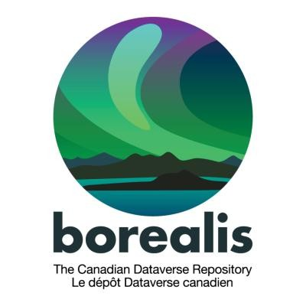



Slide 18
Let’s talk specifics…

Slide 19
Open Access to Publications
Open access publications = recent break-through!
Free, immediate, online access to the results of research
Free to reuse, e.g., to build tools to mine the content
Two routes to make sure anyone can access your papers
  Gold route: paying article processing charges (APCs) to ensure publishers makes copy open
  Green route: self-archiving Open Access copy in repository (e.g., SPECTRUM)
Find out what your publisher allows on SHERPA RoMEO http://www.sherpa.ac.uk/romeo

Slide 20
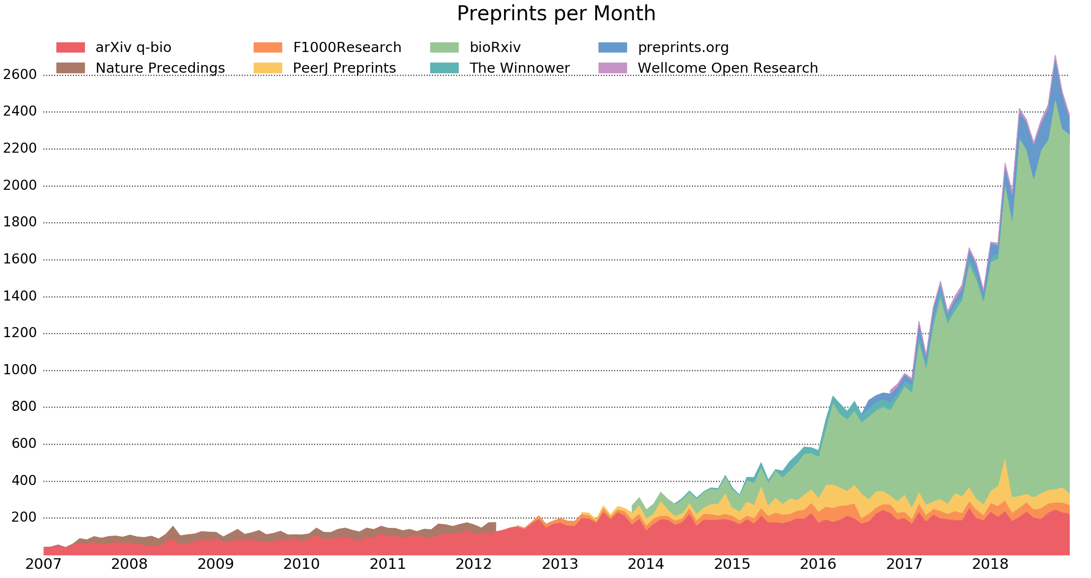
Benefit of posting pre-prints
Time stamp / credit
  Prevent getting scooped
Get feedback before submission to journals
  Makes for better papers!
Increase visibility
  Higher research impact and citations
Faster publication of results!
http://www.prepubmed.org/monthly_stats/

Slide 21
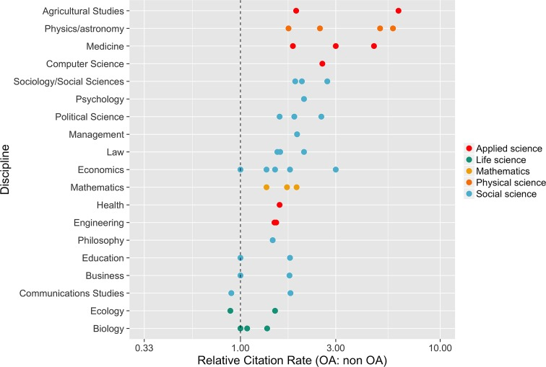
Open Access articles get more citations
https://www.ncbi.nlm.nih.gov/pmc/articles/PMC4973366/

Slide 22
How-to pre-print
When your manuscript is ready….
Upload on OSF.io, bioRxiv, PsyArXiv, Spectrum...
  ArXiv automatically tweets
Post on Twitter/X/BlueSky! Ask for feedback!
  Consider sending link of pre-print to colleagues
Collect feedback
  Give it a few weeks...
  Improve your manuscript
Submit to journal as usual...
  Update pre-prints at each round of review / new journal submission

Slide 23
Open peer review
Open identities
  Names are explicit
Open reports
  review Q&A
Open participation
  Anyone can write a review
Open interaction
  Direct reciprocal discussion

Slide 24
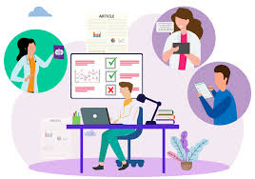
Why? Broken peer review
It’s supposed to be constructive!
Battle for high IF publication -> high competition, wrong incentives.
High error rate: 3-4 reviewers are not enough to accurately judge!
Anonymous = problematic
  Aggressive, subjective, biased reviews.
Review process opaque: review Q&A not published!
Notes:
Economist George A. Akerlof’s seminal paper, “The Market for Lemons,” (how decisions are influenced by one party having more information), was rejected several times before it could be published. Akerlov was later awarded the Nobel Prize for this and other later work.

Slide 25
Benefits of open peer review
Greater transparency
  Less bias
Increased participation to formal and informal peer review processes
  More feedback is better
  More solid findings
  More collaborations
Faster, more reliable reviews from motivated people
Opportunities for reviewers
  Engage with novel research
  Build academic networks and expertise
  Refine their own writing skills

Slide 26
How-to peer-review openly
Send unsolicited review of manuscripts to authors
  Publish them (e.g. blog, Twitter)
  Directly interact with authors (e.g. comment in bioRxiv)
Sign your reviews
  Be constructive!
  Be reasonable and show integrity
  Reviewing is about making science better, not to show off
  Be an ambassador of open science
Participate in efforts to make review Q&As public
  Careful about privacy – authors are not allowed to publish reviewer comments without consent
  Pre- vs. post-publication review...
https://www.fosteropenscience.eu/learning/open-peer-review/

Slide 27
Open Methods
Documenting and sharing workflows and methods
Sharing code and tools to allow others to reproduce work
Using web-based tools to facilitate collaboration and interaction from the outside world
Open notebook science – “when there is a URL to a laboratory notebook that is freely available and indexed on common search engines.” http://drexel-coas-elearning.blogspot.co.uk/2006/09/open- notebook-science.html

Slide 28
Benefits of open methods
Facilitates reproducibility
Increases replicability
Allows for better understanding and evaluation of Methods used
  Relates to interpretation of results
  Limitations of approaches
Speeds up experimental design
  Makes analysis tools / approaches / rationales available
  Simplifies re-analyses, including unexplored avenues

Slide 29
How-to share methods
Document everything from the outset
  Keep detailed lab notes in digital form (if possible)
  Write clean, well-documented analysis code
  Decide on a good data organization method
Publish all experimental procedures (code, notes, etc.)
  Easy to publish everything (code, manuscript, data, notes) on OSF.io
Consider sharing code bases in a more comprehensible way
  e.g. github
Digital formats, standard formats, open-source software preferred

Slide 30
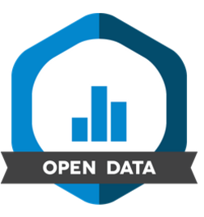
Open Data
Open data make your stuff available on the Web (whatever format) under an open license
  make it available as structured data (e.g. Excel instead of a scan of a table)
  use non-proprietary formats (e.g. CSV instead of Excel)
  use Uniform Resource Identifiers (URIs) to denote things, so that people can point at your stuff (e.g. URLs)
  link your data to other data to provide context

Slide 31
Benefits of open data
Give data a 2nd, 3rd, ... life: the FAIR principle
  Findable: data is indexed and contains searchable meta-data
  Accessible: open data and communication protocols
  Interoperable: data can be combined with other data and tools • Re-usable: meaningful metadata and open license
  Re-use of data gives you citations, recognition and visibility
Satisfaction of making an impact in science and society
You will get known for your datasets as well as for your science

Slide 32
Open Data is normal in some areas
Physics (e.g., CERN)
Astronomy
Genetics (COVID-19 varients)
Climate research
Machine Learning

Slide 33
How-to make data available
Look for good examples in your field
Organize your data well right from the start
Use standard formats if possible
De-identify data (and follow ethics guidelines)
Publish data and metadata together, including
  Protocols
  Analysis pipeline
Link to paper
1. Publish in field- specific database
2. Publish on general purpose repository / database (e.g. OSF.io)
3. borealisdata.ca

Slide 34
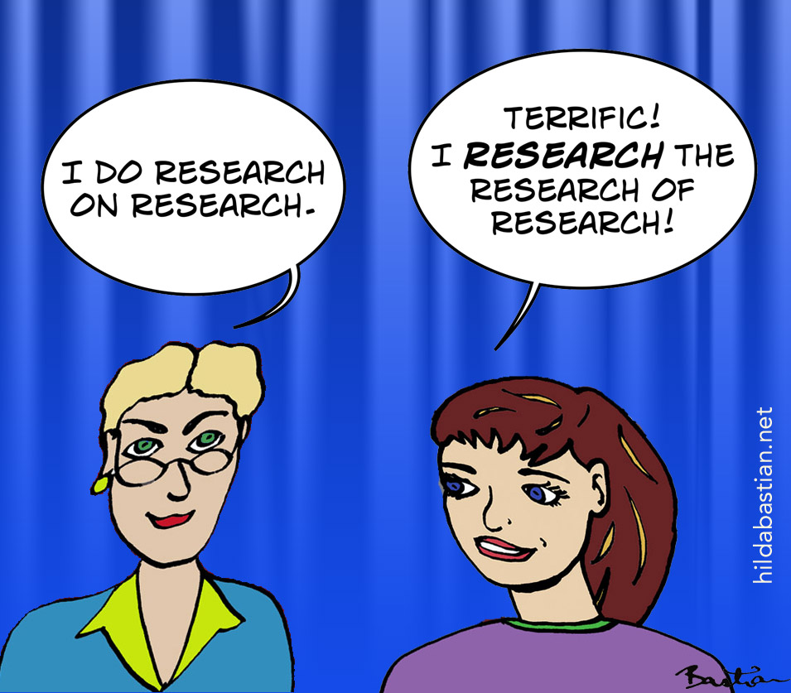
The new identity of pre-registration

Slide 35
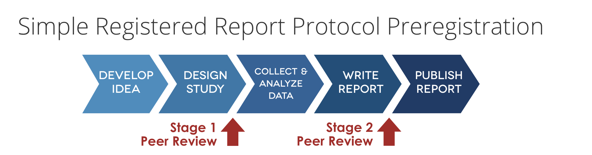
Pre-Registration/Registered Reports
Ideas, hypotheses, and methods to test them should be the only thing we control in science!
Write a proposal: Intro, Hypotheses, Methods, Analyses (pilot data)
Publish the proposal BEFORE collecting data!

Slide 36
Pre-registration / registered reports
Guarantees publication
  If original methods are followed
Main conclusions need to come from originally proposed analyses
Does not prevent exploratory analyses
  Needs to be labeled as such

Slide 37
Benefits of pre-registrations / registered reports
Makes your science better by increasing the credibility of your results
Allows you to stake your claim to your ideas earlier
  Keeps you honest
Forces you to really think your project through
  Identify gaps in knowledge and reasoning
It’s easy and you can win a $1,000 prize for publishing the results of your preregistered research.

Slide 38
How-to pre-register
As “registered report”
  See specific journal guidelines:
As simple “pre-registration”
  On OSF.io
When to preregister?
  Right before your next round of data collection
  After you are asked to collect more data in peer review
  Before you begin analysis of an existing data set

Slide 39
Benefits of Open Scholarship for early career researchers
Become a pioneer
Distinguish yourself from the crowd
Receive higher citations
Get known faster
Demonstrate research and societal impact
Enhances your credibility
Develop a better research network
Increasingly a requirement!
Unstoppable & Necessary!

Slide 40

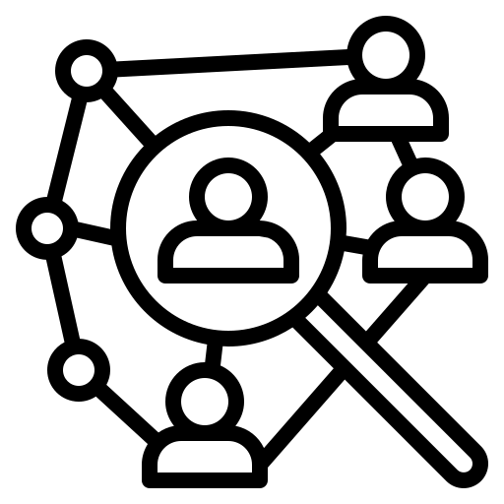

Humanities
Social Sciences
Sciences

Slide 41
Open Scholarship - readings
Open Science handbook: https://zenodo.org/record/1212496#.W1deLbgpDb0
The Turing Way https://the-turing-way.netlify.app/communication/open.html
FOSTER Open Science: www.fosteropenscience.eu
Open Science Foundation: www.OSF.io
Center for Open Science: www.cos.io
www.opensource.com
www.openscience.com

